Slide 1

K-Means and Decision Tree Training
April 2022

Slide 2
K-Means Case Study - McDelivery

Slide 3
Process Flow
Creation of Derived Variables
Create variables necessary for EDA & segmentation
Exploratory Data Analysis
Explore variables that might be significant for segmentation process
Segmentation Process: Round 1
Align initial segmentation model & segment traits which we need to focus on
Segmentation Process: Round 2
Share and Align final segments
Profile segments
Deeper understanding of segments from the perspective of product, price, etc.

Slide 4
Selected Variables
Types | Variables | Type | Variable details
High Frequency | Customers with monthly frequency of more than once | Categorical | Frequency = Overall total number of orders / total number of active months
Single/ Group order | % of orders with 2 or fewer main items | Numeric | Main Items could be either EVM or ALC
Group identifier | At least 50% of orders are with 3 or more main items & without Happy Meal
 |  | Categorical
Value conscious identifier 1 | Customers who have ordered ‘value items’ more than 50% out of their total orders | Categorical | Value was identified using value mains: ROD: FOF, McChicken, BBQ beef burger, BF: Sausage McMuffin, Chicken McMuffin, FOF
Value conscious identifier 2 | Customers who have ordered promotional items at least once | Categorical | Identifier for promotion = promo code
Upsizing identifier | Customers who have upsized more than 50% out of their total orders | Categorical | Upsiziing is identified using ‘Size’ variable
Day & Daypart | Orders made during specific daypart morning | Numeric | Morning: 4-11am/12pm Afternoon: 11am/12pm-4pm Evening: 4pm-10pm, Late Evening: 10pm-4am Weekday: Monday morning to Friday Afternoon Weekend: Friday Evening to Sunday Late Evening
 | afternoon
 | evening
 | Evening Orders made during weekend/weekday
 | weekend
 | weekday
Happy Meal identifier | Customers who have ordered Happy Meal | Categorical | If customer has ordered Happy Meal at least once, value of identifier is true
Couples identifier | Customers who order as couples 30% or more out of the total orders | Categorical | Couple behavior was defined by : Total number of orders with either HSB as the sole main item 2 items with both being EVMs

Slide 5
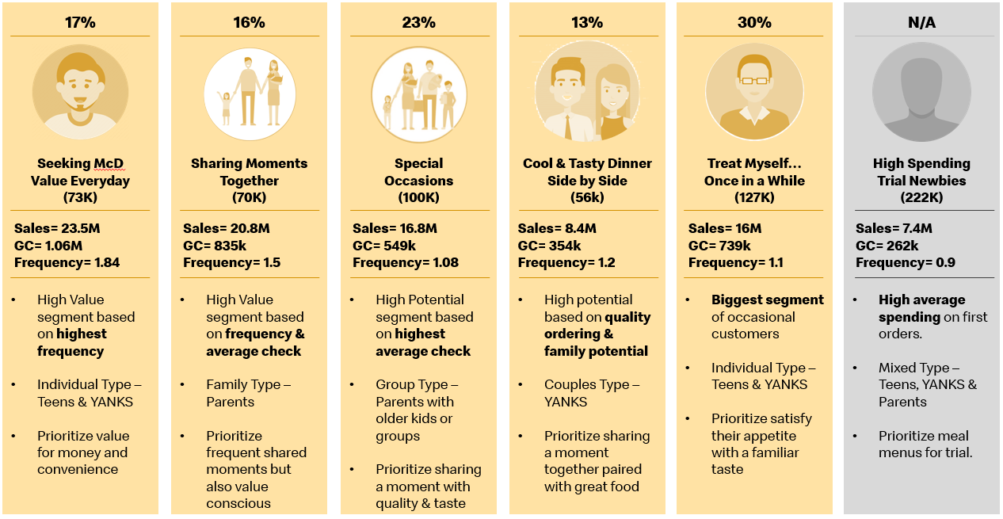
Result Segments

Slide 6
K-Means Case Study - Prudential

Slide 7
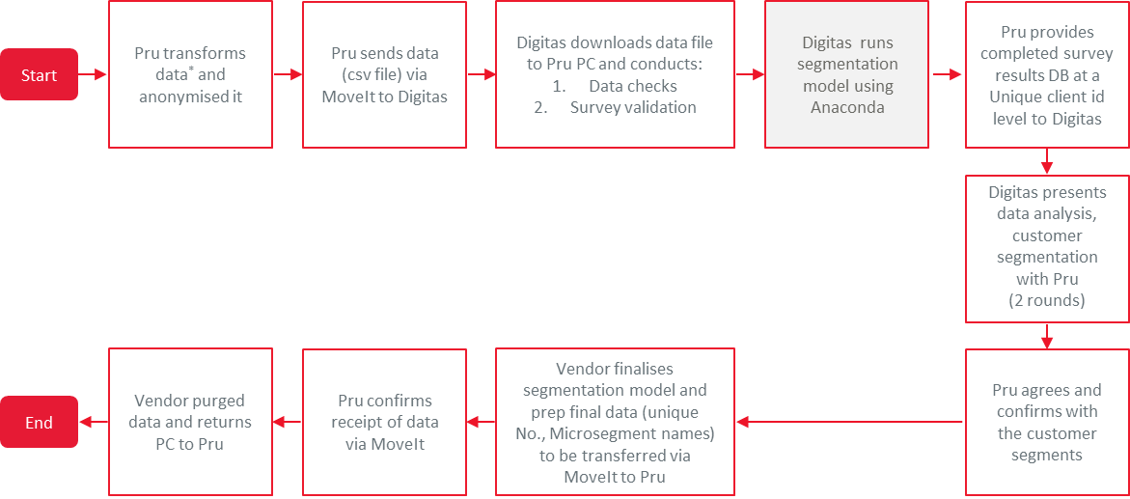
Process Flow - Project

Slide 8
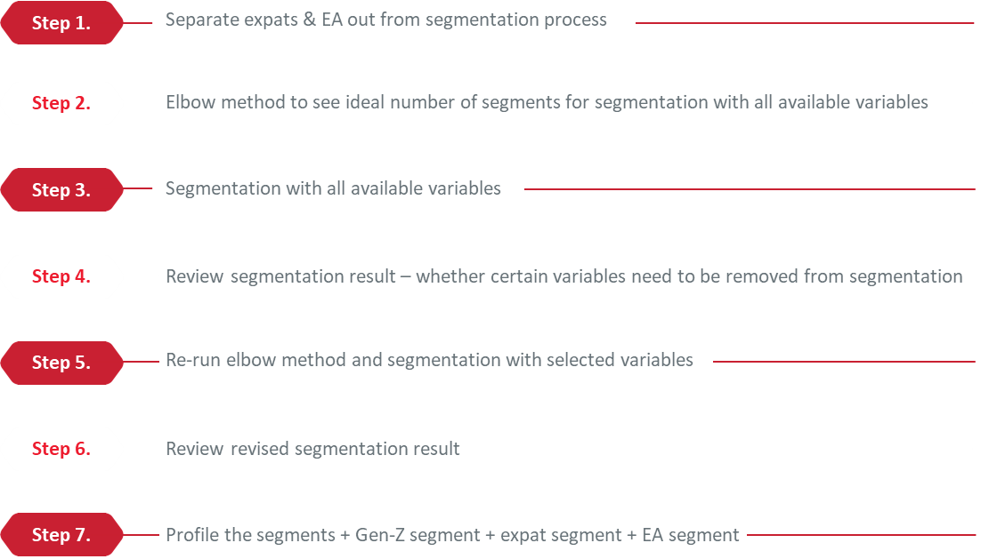
Process Flow – Segmentation and Profiling

Slide 9
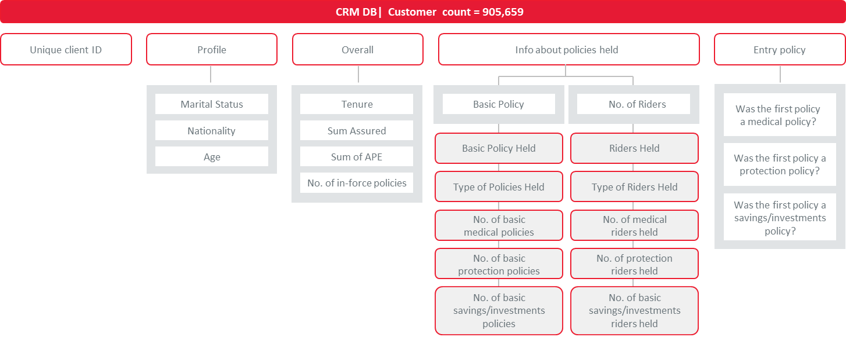
Selected Variables

Slide 10
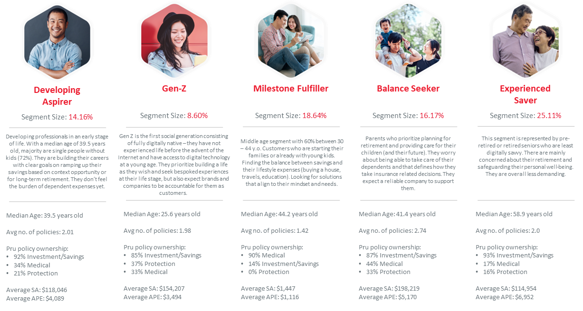
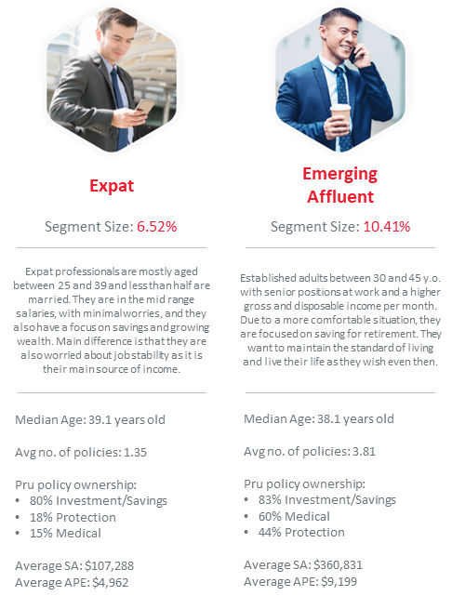
Result Segments

Slide 11
Decision Tree/Random Forest Case Study – McDelivery Family Analysis

Slide 12
Methodology
ROUND 1
EDA - Demographics and purchase behaviour of sample size of self-identified contacts with children <12 y.o. in their household
1. Identify contacts who have answered Poll=Yes (n=6,552) and Poll=No (n=4,611)
2. Overlay Family Moments Together on Poll=Yes and Poll=No
3. Overlay demographics and purchase behaviour on Poll=Yes and Poll=No
ROUND 2
Predictive Model - Observations of this known sample of n=11,163 customers will be used to make a prediction of potential parents in the unidentified rest of population.
1. Approve usage of proposed variables in predictive model
2. Run the model to non-identifiable "contacts with <12y.o. in household" in existing database
3. Tag these contacts for future use case
4. Summary of survey responses to inform of family-content preference

Slide 13

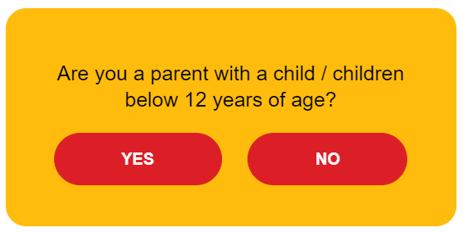
Poll Survey
 | Poll 1 | Poll 2 (Opened did not click) | Poll 3 (Did not open)
Date | Wed, Jul 21, 2021 1:00 pm | Fri, Jul 23, 2021 5:05 pm | Fri, Jul 23, 2021 5:07 pm
Subject line | Help us understand you better | Just a Yes or No question? | Hello Want emails that were created just for you?
Sent | 456,012 | 45,980 | 402,171
Open | 13.2% (60,118) | 57.5% (26,377) | 6.9% (27,653)
Answered | Yes 6,552 No 4,611 Total=11,163

Slide 14
R2: Prediction Model – Flow
Machine learning process
Training and Validation Set
Learning Phase
How the learning phase goes
Labeled (Surveyed)
Customers: n=11,163
(from Poll; 6,552 YES and 4,611 NO)
Training
With 80% of labeled data
Validation
With 20% of
labeled data
Prediction Set
Prediction Phase
Training of the model
Evaluation of the model
Unlabeled
customers
Predicted Set

Slide 15
R2: Prediction Model – Variables
Variables
Identifier
Predicted (y)
Predictor (x)
Customer ID
Parent/Not Parent
Demographics
Overall KPI
Purchase Behavior
Age
GC
Order time
Order content
AC
Avg. main item count
GC weekday morning*
GC containing Happy Meal*
GC weekday afternoon*
GC containing McNuggets*
GC weekday evening*
GC containing Milo*
GC weekday late evening*
GC weekend morning*
GC weekend afternoon*
GC weekend evening*
GC weekend late evening*
* During calculation, these variables are converted into ‘% of total orders’ by dividing them with GC
** We tried adding in month of order as another purchase behavior variable, but the result did not improve and there are no significant differences

Slide 16
Classification – Decision Tree Example
All customers
Happy Meal order propensity > 0.5?
Happy Meal order propensity <= 0.5?
Happy Meal order propensity > 0.5
Happy Meal order propensity <= 0.5
Average number of main items in order >3
Average number of main items in order <=3
Average number of main items in order >4
Average number of main items in order <=4
y=1 (Family type customer)
y=0 (Not a family type customer)
y=1 (Family type customer)
y=0 (Not a family type customer)

Slide 17
R2: Prediction Model – Model Validation Results
How did the model perform?
Accuracy: 70%
Precision: 72%
Recall: 81%
How to read the scores?
Accuracy:
70 people out of 100 are predicted correctly (ie., parents marked as parents or vice versa)
In other words..
30 people are predicted incorrectly (i.e., parents marked as non-parents or vice versa)
Precision:
72 actual parents out of 100 predicted parents
In other words..
28 non-parents marked as parents
Recall:
81 predicted parents out of 100 actual parents
In other words..
19 actual parents marked as non-parents

Slide 18
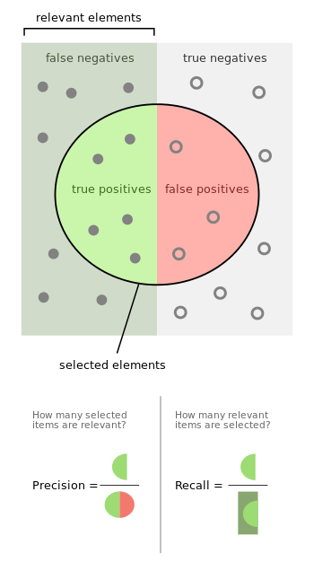
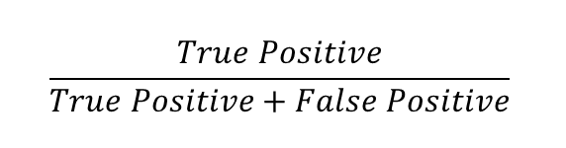
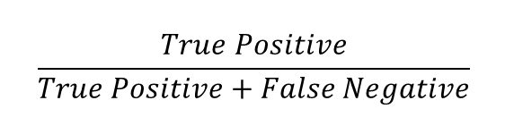
Precision and Recall
Precision (72%)
vs.
Recall (81%)
$$\frac{True Positive}{True Positive+False Positive}$$
$$\frac{True Positive}{True Positive+False Negative}$$
Measures how many customers are actually parents, out of all who are predicted as parents
Measures how many customers are predicted as parents, out of all who are actually parents
More important if we’re concerned about
sending parent comms to actual non-parents
More important if we’re concerned about
NOT sending comms to actual parents
Also, accuracy (70%) = correct prediction/total, or (true positive+true negative)/(TP+FP+TN+FN)

